Slide 1
SOLAR TRACKING SYSTEM
PREPARED BY
NAVEEN GUPTA
Mechanical engineering
Roll no: 1313240109

Slide 2
CONTENT
INTRODUCTION
WHAT IS SOLAR TRACKERS
NEED OF SOLAR TRACKERS
TYPES OF SOLAR TRACKERS
WORKING PRINCIPLE
HARDWARE COPONENTS OF SOLAR TRACKER
COMPARISON OF STATIONARY VS TRACKED SOLAR ENERGY
ADVANTAGES
DISADVANTAGES
CONCLUTION
REFERENCE

Slide 3
INTRODUCTION
Renewable energy solutions are becoming popular.
Maximizing output from solar system increases efficiency.
Presently solar panels are of fixed type which lower the efficiency.
Maintaining vertical direction between light and panel maximizes efficiency.
Solar tracking system has 35% higher generating power than fixed.
Solar tracking system based on PLC can adjust automatically orientation of panel

Slide 4
WHAT IS SOLAR TRACKER?
A Solar tracker is a device used for orienting a solar photovoltaic panel or lens towards the sun by using the solar or light sensors connected with the machine ( ex: stepper motor, servo motor, gas filled piston ).

Slide 5
NEED OF SOLAR TRACKER
Increase Solar Panel Output
Maximize efficiency of the panel
Maximize Power per unit Area
Able to grab the energy through out the day

Slide 6
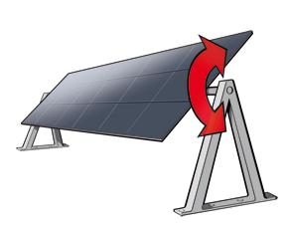
TYPES OF SOLAR TRACKERS
Single axis trackers
Single axis solar trackers can either have a horizontal or a vertical axle.

Slide 7
Dual Axis Trackers
Double axis solar trackers have both a horizontal and vertical axis
It can track the Sun's apparent motion exactly anywhere in the world.

Slide 8
OVERVIEW OF PRESENT TRACKER DRIVE TYPES
Solar Tracker Drives
1.Passive Trackers
2.Active Trackers
3. Open Loop Trackers

Slide 9
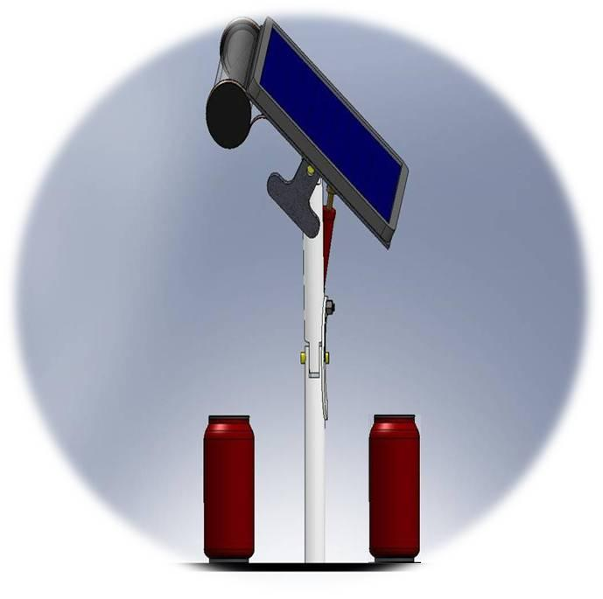
1. PASSIVE (GAS) TRACKERS
Passive trackers use a compressed gas fluid in two canisters .
The mechanism is in such a way that if one side cylinder is heated other side piston rises causing the panel to tilt over the sunny side.

Slide 10
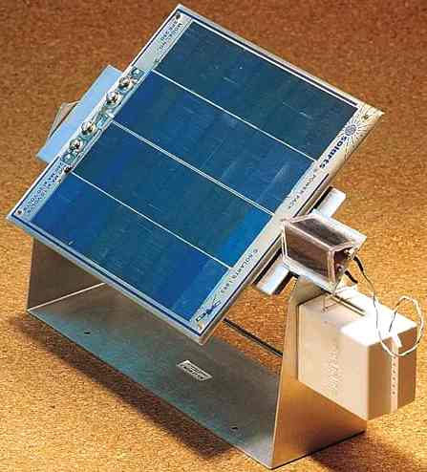
2. ACTIVE TRACKERS
measure the light intensity from the sun by using light sensors
And determine where the solar modules should be pointing

Slide 11
3. OPEN LOOP SOLAR TRACKERS
Open loop trackers determine the position of the sun using computer controlled algorithms or simple timing systems.
1. Timed Trackers
A timer is used to move the tracker across the sky.
2. Altitude / Azimuth Trackers
It uses the astronomical data or sun position algorithms to determine the position of sun for any given time and location by using PLC

Slide 12
WORKING PRINCIPLE
Auto-tracking control system composed of PLC, sensors, signal processing units, PV cells, electromagnetic and mechanical motion control modules and power supply systems.
Panel detects the sun light strength to sensors
The sensors output is given to the PLC which compares it and produces an equivalent output so as to rotate the motor and align the panel in the direction of sun

Slide 13
HARDWARE COMPONENTS
SOLAR PANEL
LDR SENSORS
STEPPER MOTOR
RELAY
PLC

Slide 14
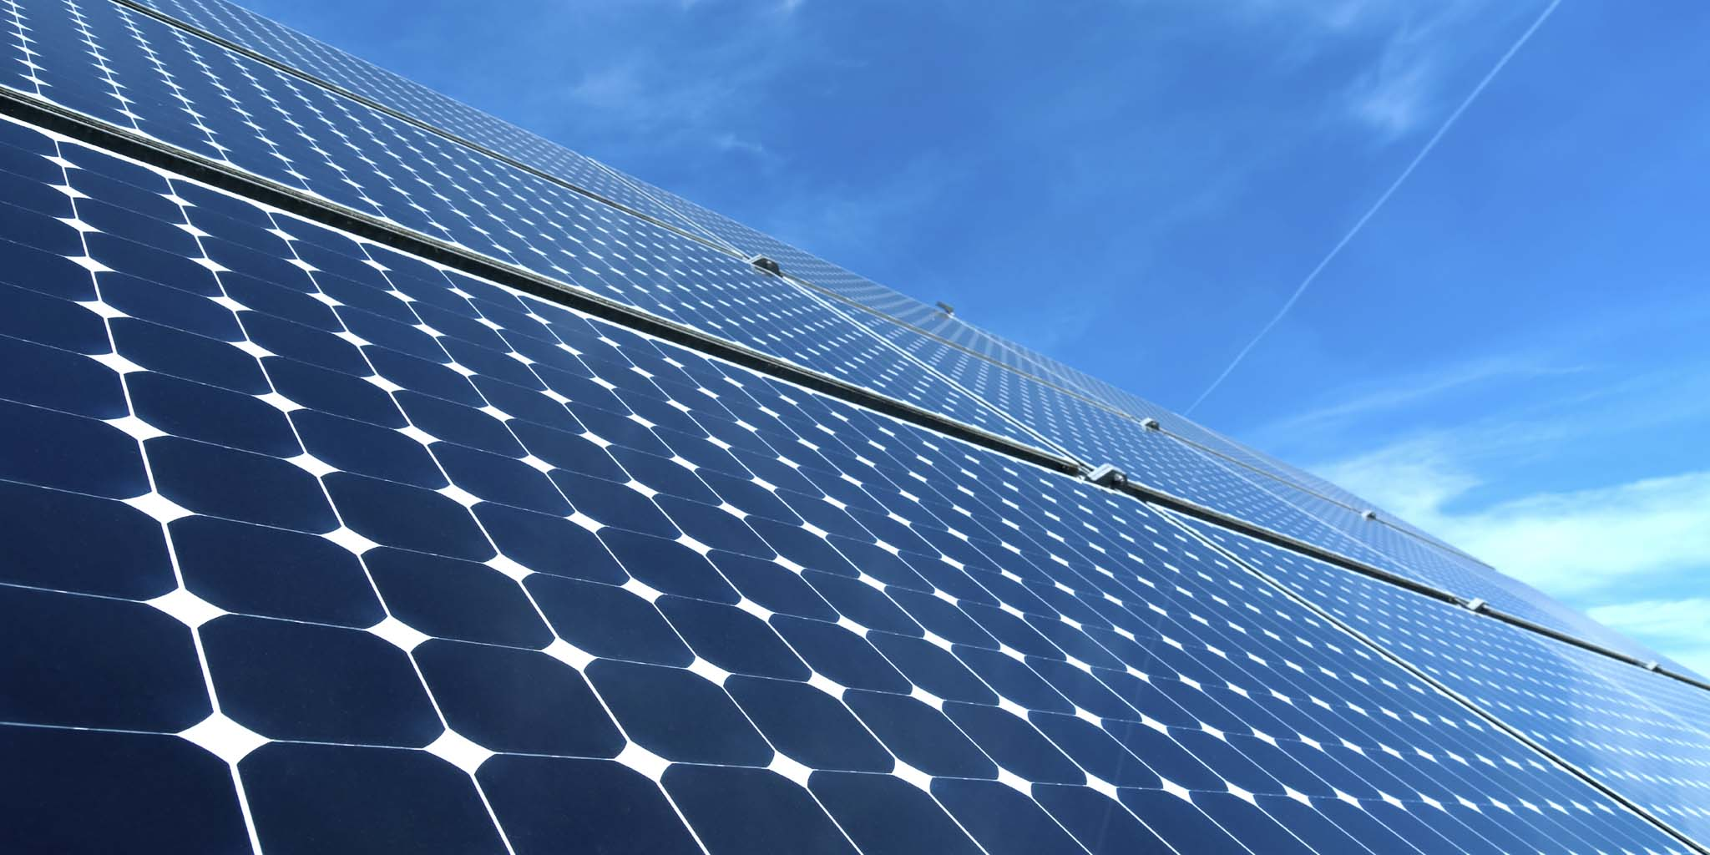
SOLAR PANEL
Its made up of a number of solar cells connected in series internally
Convert solar energy to electricity.
Based on photo voltaic effect.
Photo voltaic effect produces a change in electrical characteristics when light is incident upon it.

Slide 15
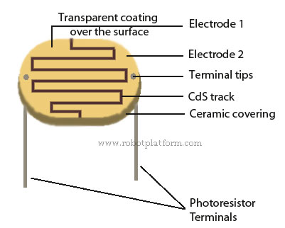
LDR SENSORS
A high resistance semiconductor whose resistance decreases with increasing incident light intensity.
When light falls on such a semiconductor, the valence electrons receive the light energy incident and jump to the conduction band.
The conductivity of the device increases, decreasing its resistivity.

Slide 16
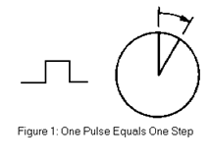
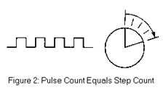
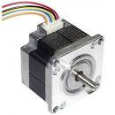
STEPPER MOTOR
Its an electromechanical device which converts digital pulse inputs to incremental shaft rotation.
Used for precision positioning control applications.
Its controlled by a series of electromagnetic coils.

Slide 17
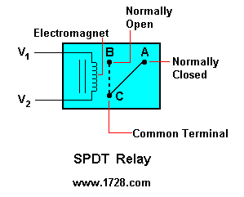
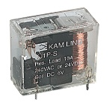
RELAY
Its an electrically operated switch used for switching of large currents.
Uses an electromagnet to operate a switching mechanism mechanically

Slide 18
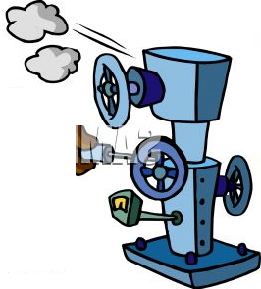
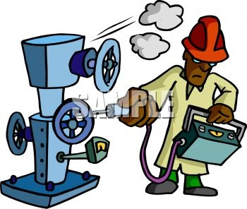
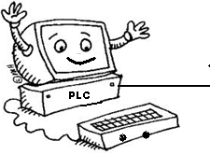
PROGRAMMABLE LOGIC CONTROLLER(PLC)

Slide 19
C0MPARISON OF SOLAR ENERGY

Slide 20
ADVANTAGES
Simple
Low cost
Eco-Friendly
We can monitor directly using PC
Tracking accuracy is more
Reduce the usage of power from power grid

Slide 21
DISADVANTAGES
Solar electricity is not available at night and is less available in cloudy weather conditions. Therefore, a storage or complimentary power system is required.
Limited power density.
Solar cells produce DC which must be converted to AC when used in currently existing distribution grids

Slide 22
CONCLUSION
The invention of Solar Tracking System helps us improve the performance of PV solar system in a simple way
Used relative method of sunlight strength.
Established a model of automatic tracking system to keep vertical contact between solar panels and sunlight.
Improved the utilization rate of solar energy and efficiency of photovoltaic power generation system.

Slide 23
REFERENCE
http://www.alltronics.com/stpper _motor.html
http://fsae.mae.cornell.edu/
http://www.optimum-tracker.com/solartrackers/

